Slide 1
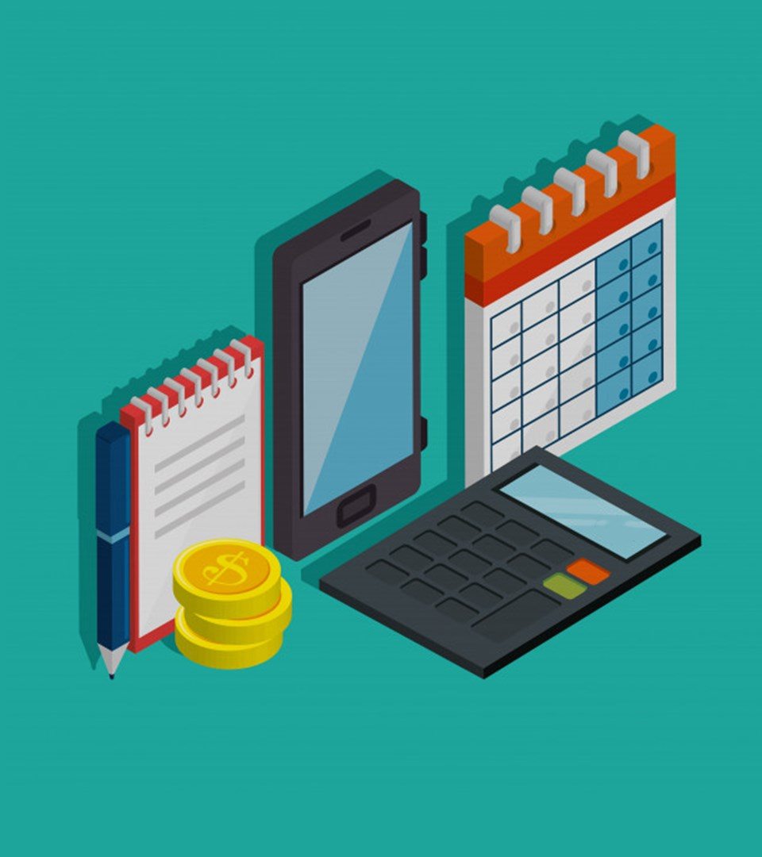
Simple Expense tracker
Based on a tutorial made by: Sourav Johar
Code by: Joonsoo Kim
https://github.com/ksu-is/Simple-Expense-Tracker

Slide 2
simple expense tracker is created for those who needs to keep a watch on their expenses. It helps users to analyze their spending habit and prevents user to overspend their budget.

Slide 3
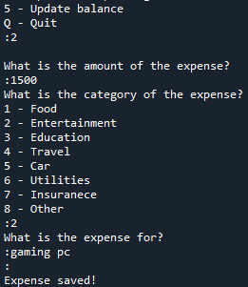
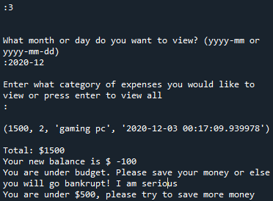
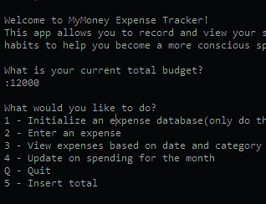
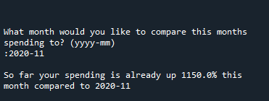
The simple expense tracker helps you to 1. keep a track of your expense 2. update your balance and enter an expense 3. allows you to categorize your expense history 4. compare your spending based on months 5. shows you a list on your expenses based on month

